Slide 1
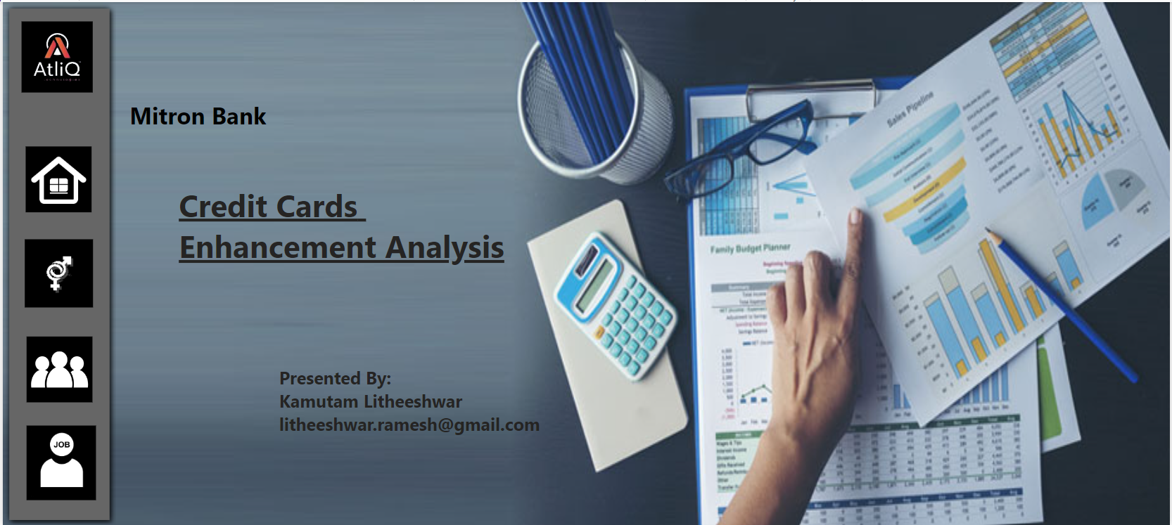

Slide 2
Problem Statement.
Mitron Bank:
Mitron bank is a legacy financial institution headquartered in Hyderabad.
It want to introduce the new features in their credit cards to enhance their products and reach into the financial market.
AtliQ Data Services
AtliQ Data Services came to know about the problem of mitron bank and approached with a proposal to implement the project

Slide 3
Mr Bashnir Rover – statergy director of mitron bank
He was not convinced with the proposal of atliQ Data Services and asked them to provides the insights on small dataset of 4000 customers along with their details instead of handling entire project.
Peter Pandey- Data Analyst
Peter Pandey is an data analyst in AtliQ Data Services and asked by his manager (Tony Sharma) to analyse and provide the useful insights which helps to the product statergy team of mitron bank to include new features in to their credit cards and enhance their product offerings
Tony Sharma – Manager At AtliQ Data Services
The manager of Peter Pandey who also supported by providing some insights to Peter Pandey.

Slide 4
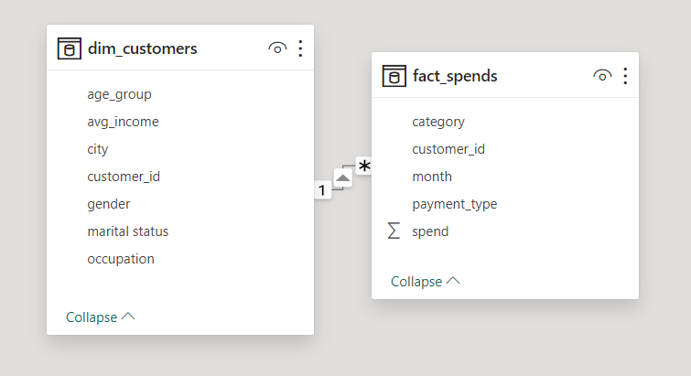
Dataset

Slide 5
Insights from Tony Sharma
Demographical classifications.
Average income utilization.
Spending insights.
Key customer segments.
Credit card feature recommendation.
Additional thoughts.
.

Slide 6
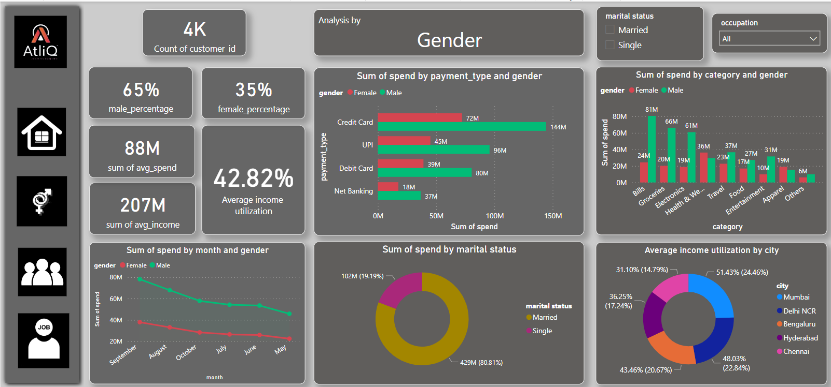

Slide 7
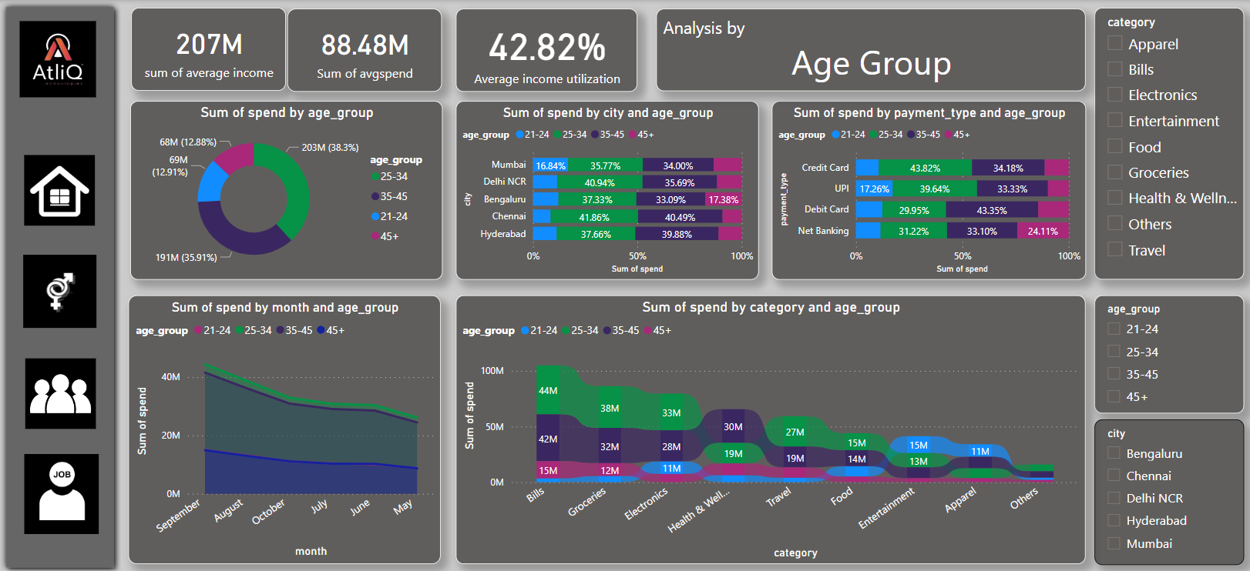

Slide 8
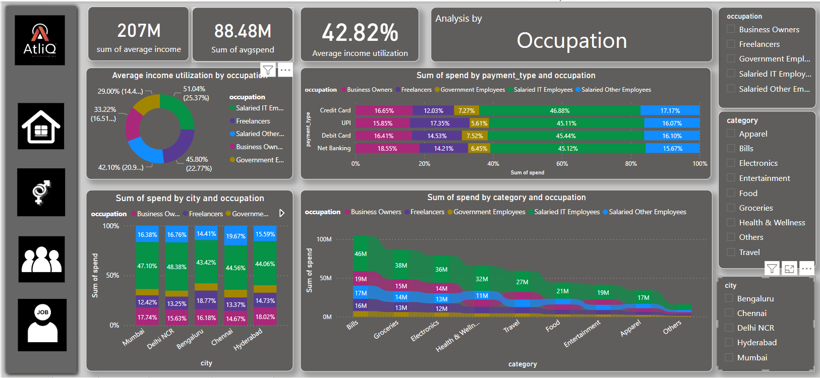

Slide 9
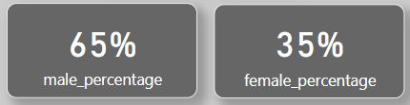
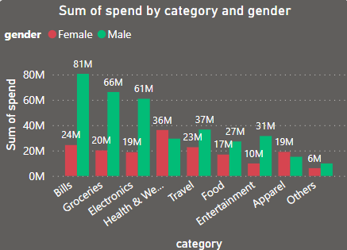
My Insights
Credit cards for women:
Credit cards designed specifically for women may include features that cater to their unique needs and preferences.
Tailored rewards programs that include discounts or cashback on purchases that are commonly associated with women's preferences, such as shopping, beauty products, or wellness services.
.

Slide 10
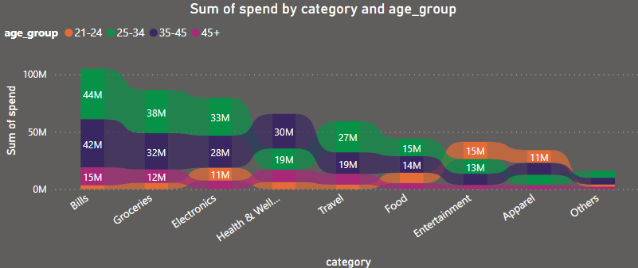
My Insights
Specialized credit cards:
Entertainment Rewards:
Cashback or rewards for entertainment expenses, including movie tickets, concerts, and streaming services.
Student-Friendly Rewards:
.

Slide 11
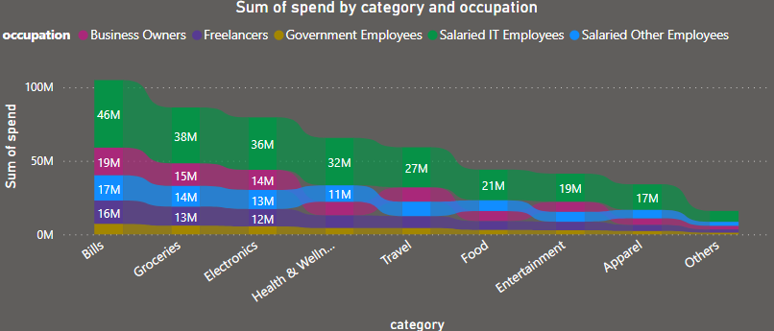
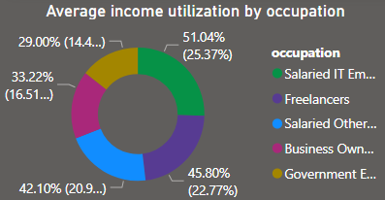
My Insights
Credit cards for IT Employees:
Tech-Related Rewards:
Rewards and cashback on tech purchases, such as gadgets, software, and electronics.
E-commerce Partnerships:
Exclusive deals, discounts, or cashback offers with popular e-commerce platforms where tech-related products are commonly purchased.
.

Slide 12
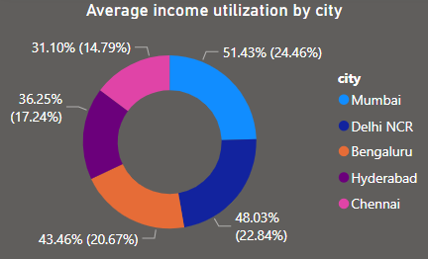
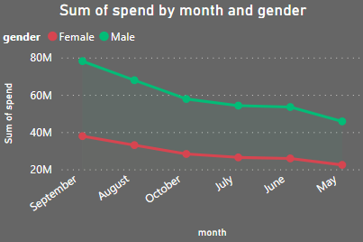
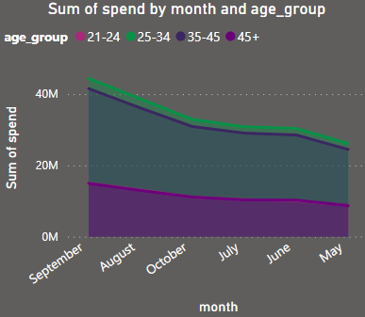
My Insights
Mumbai customers:
Most of the customer from Mumbai they are utilizing their income more . We need to provide some benefits to the Mumbai customers for there business establishment ,purchases , transportation..etc.
Vouchers in September:
.

Slide 13
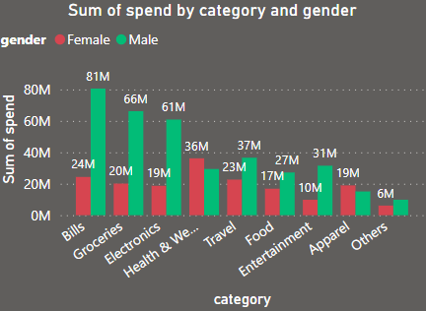
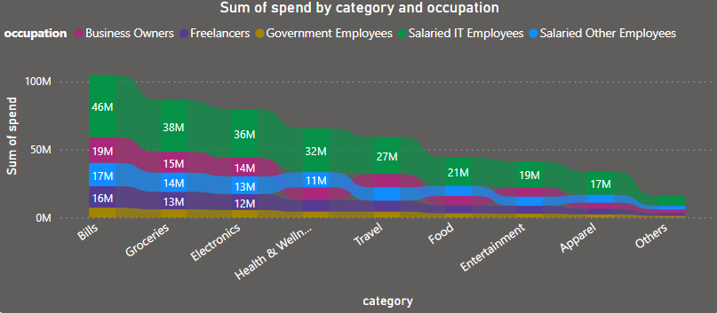
My Insights
Reward on Bills,Groceries purchases:
Credits cards through online:
.

Slide 14
Thank You

